Slide 1
A Measure of Sentence Relatedness using Convolution Neural Networks
(Nerissa D’Souza, CCE-NNSP1)

Slide 2
Abstract
The Aim of this project is to understand the following questions:
How can Convolution Neural Networks be applied for text analysis ?
How is text processed into an input suitable for Neural Networks ?
What type of basic network architecture we can start with ?
What are the network changes for a better result ?
For this I used sentence pairs and the expected result is a measure of similarity or a relatedness score between the given pair.

Slide 3
SICK Dataset : Sentences Involving Compositional Knowledge
The dataset consists of sentence pair associated relatedness score between 1-5 which was formed via crowd scouring of 200,000 judgements
The dataset has score distribution in the following ratios [1-2):[2-3):[3-4):[4-5] => 10:14:39:37
The scores do not deal with negation [i.e a positive and negative sentence on the same topic are still related]
Examples :
A lone biker is jumping in the air A biker is jumping in the air, alone 5
There is no biker jumping in the air A lone biker is jumping in the air 4.2
Two dogs are playing by a tree Two dogs are playing by a plant 4.6
Two teams are competing in a baseball game A player is running with the ball 3
The man's jumper is in the empty pool A lone biker is jumping in the air 1.4

Slide 4
Input Preparation: Global Vectors for Word Representations )
GloVe is an unsupervised learning algorithm for obtaining vector representations for words
A co-occurrence matrix is constructed using a weighted window of size 10 [i.e word pairs that are d words apart contribute 1/d to the total count]. Each element is X_{ik}
The word vectors represent information about how every pair of words i and k occur,
w_{i}^{T}w_{k} + b_{i} + b_{k} = log (X_{ik})
There is a weighting function to ensure that rare or very frequent co-occurrences are not under or over weighted
The length of word vector [b_{i} w_{i}] is configurable and is called the embedding dimension
Other algorithm alternatives for word vectors are word2vec, senna
In this project we use pre-trained vector obtained by training GloVe on the Wikipedia 2014+Gigaword5 dataset with 50, 200, 300 dimensions. The dataset has 6 billion word tokens
Building each word in the sentence from the word embedding’s, yields a matrix x_{nd} ,n is the sentence length, d is the embedded dimensions.
If a word embedding does not exist in the pre-trained vector vocabulary, use the embedding of an unknown token <unk>, which is initialized to a uniform distribution (-0.05, 0.05)
The minimum sentence length is associated with the max convolution window size we experiment with

Slide 5
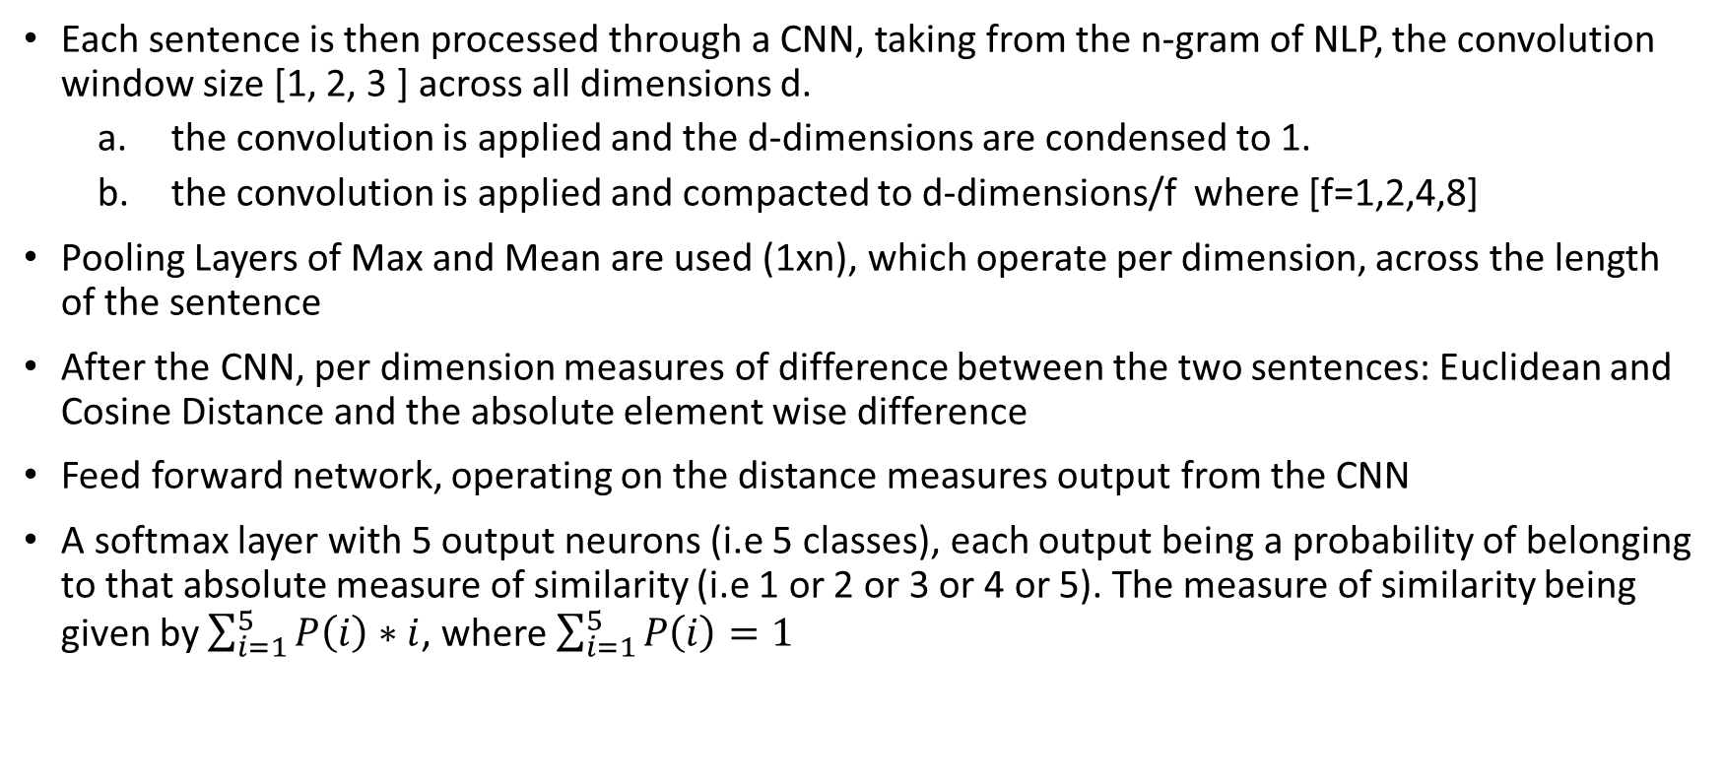
Network Architecture
Each sentence is then processed through a CNN, taking from the n-gram of NLP, the convolution window size [1, 2, 3 ] across all dimensions d.
the convolution is applied and the d-dimensions are condensed to 1.
the convolution is applied and compacted to d-dimensions/f where [f=1,2,4,8]
Pooling Layers of Max and Mean are used (1xn), which operate per dimension, across the length of the sentence
After the CNN, per dimension measures of difference between the two sentences: Euclidean and Cosine Distance and the absolute element wise difference
Feed forward network, operating on the distance measures output from the CNN
A softmax layer with 5 output neurons (i.e 5 classes), each output being a probability of belonging to that absolute measure of similarity (i.e 1 or 2 or 3 or 4 or 5). The measure of similarity being given by $\sum_{i=1}^{5}{P\left(i\right)∗i}$, where $\sum_{i=1}^{5}{P\left(i\right)=1}$

Slide 6
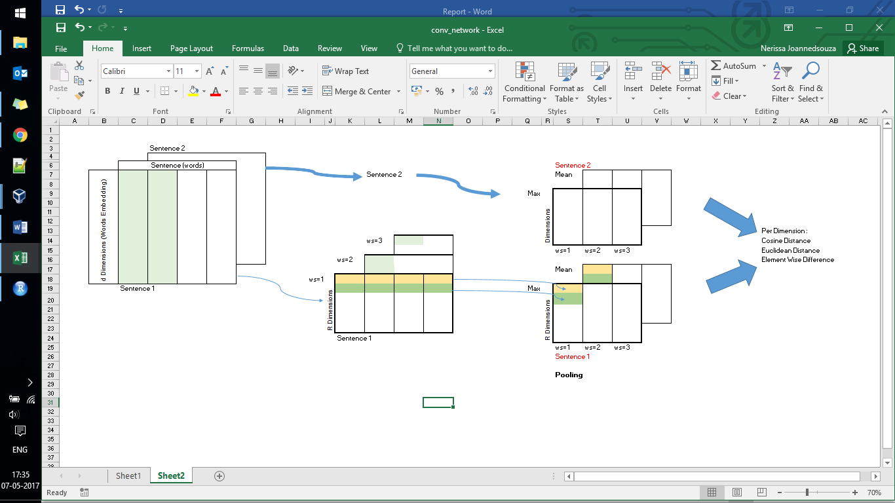
Network Architecture .. Contd..

Slide 7
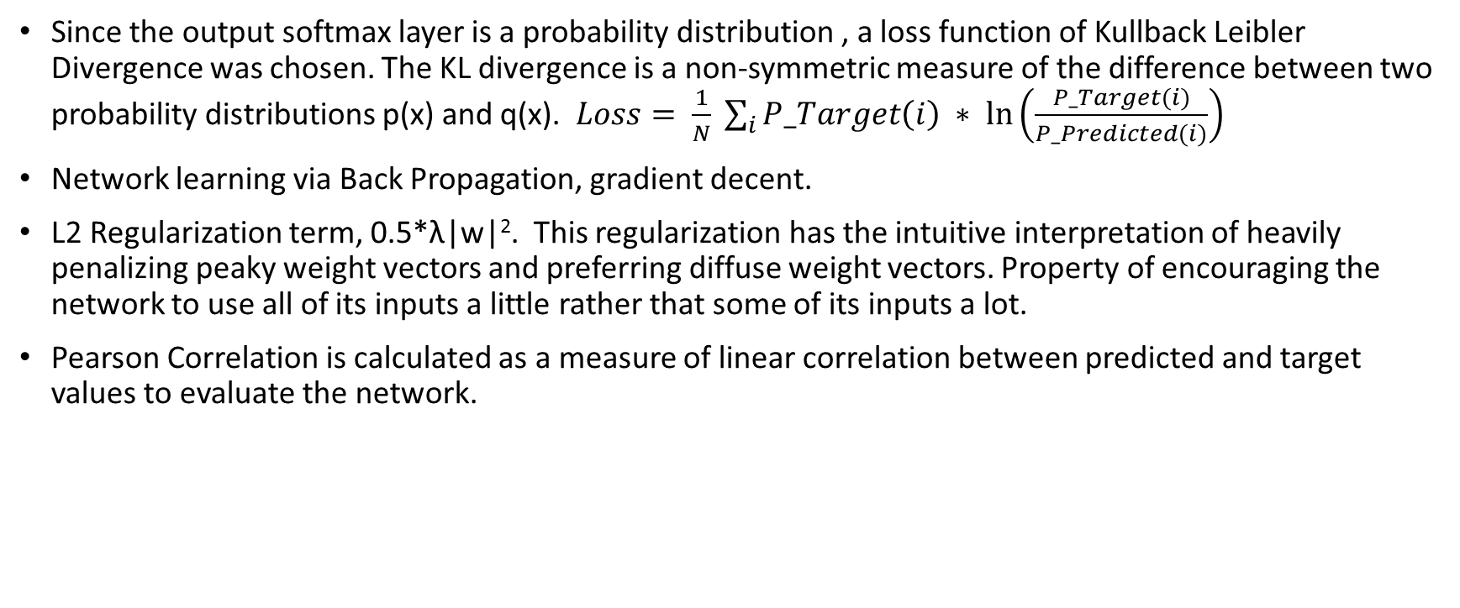
Network Architecture .. Contd..
Since the output softmax layer is a probability distribution , a loss function of Kullback Leibler Divergence was chosen. The KL divergence is a non-symmetric measure of the difference between two probability distributions p(x) and q(x). $Loss= \frac{1}{N} \sum_{i}{P_Target\left(i\right) ∗ \ln\left(\frac{P_Target(i)}{P_Predicted(i)}\right)}$
Network learning via Back Propagation, gradient decent.
L2 Regularization term, 0.5*λ|w|². This regularization has the intuitive interpretation of heavily penalizing peaky weight vectors and preferring diffuse weight vectors. Property of encouraging the network to use all of its inputs a little rather that some of its inputs a lot.
Pearson Correlation is calculated as a measure of linear correlation between predicted and target values to evaluate the network.

Slide 8
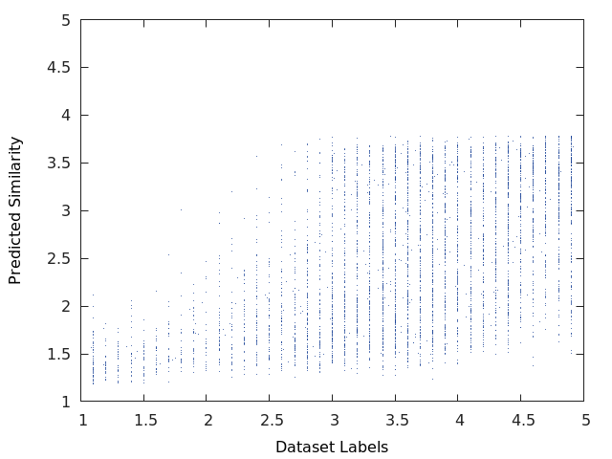
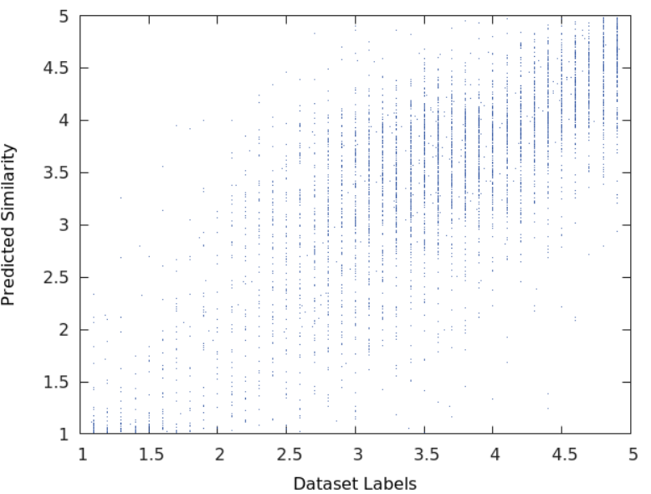
Network Output while learning..

Slide 9
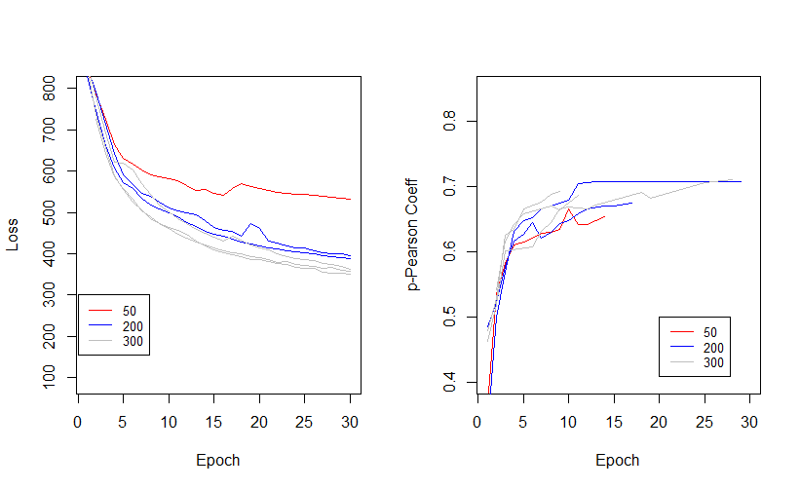
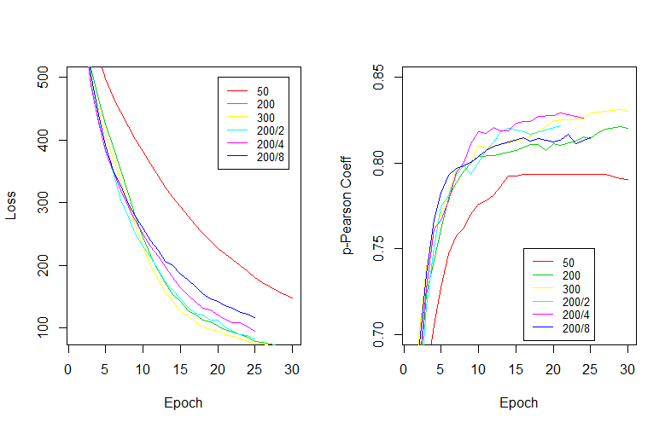
Evaluation of the Network
Figure 4: Results from Architecture (a)
Figure 5: Results from Architecture (b)

Slide 10
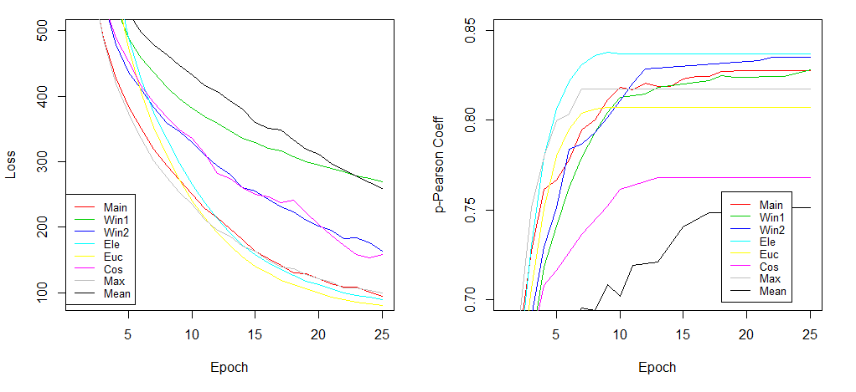
Evaluation of the Network
Figure 6: Network Component Analysis

Slide 11
Next steps and Applications
A different dataset, involving variations in other characteristics associated with NLP.
In the software industry, detecting similarity in defects raised or trouble tickets, historic and present is of value. However, the language used is not necessarily in structural and grammatical English. If the word vector embedding is pre-trained on such data, and used in a CNN network as described in the project, would the network yield similar results.

Slide 12
References
[1] http://www.wildml.com/2015/11/understanding-convolutional-neural-networks-for-nlp/
[2] http://clic.cimec.unitn.it/composes/sick.html and
http://clic.cimec.unitn.it/marco/publications/marelli-etal-sick-lrec2014.pdf
[3] https://nlp.stanford.edu/projects/glove/
[4] Multi-Perspective Sentence Similarity Modeling
with Convolutional Neural Networks, Hua He, Kevin Gimpel, and Jimmy Lin http://ttic.uchicago.edu/~kgimpel/papers/he+etal.emnlp15.pdf , https://github.com/castorini/MP-CNN-Torch
[5] Convolutional Neural Networks for Sentence Classification, Yoon Kim, New York University, https://arxiv.org/abs/1408.5882
[6] Natural Language Processing (Almost) from Scratch, http://www.jmlr.org/papers/volume12/collobert11a/collobert11a.pdf
[7] http://ufldl.stanford.edu/tutorial/supervised/SoftmaxRegression/
[8] http://ufldl.stanford.edu/tutorial/supervised/ConvolutionalNeuralNetwork/
[9] http://alt.qcri.org/semeval2014/task1/
[10] http://web.engr.illinois.edu/~hanj/cs412/bk3/KL-divergence.pdf

Slide 13
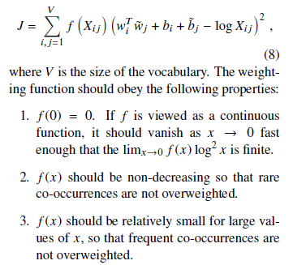
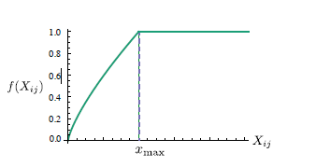
GloVe .. Additional

Slide 14
Description | Embed Dimension | Reduced Dimension After Convolution | p (Pearson Coefficient) | Nr CCN o/p | Nr w params
(a) | 50 | 1 | 0.65303 | 12 | 1511
(a) | 200 | 1 | 0.7077 | 12 | 3311
(a) | 300 | 1 | 0.70929 | 12 | 4511

Slide 15
Description | Embed Dimension | Reduced Dimension After Convolution | p (Pearson Coefficient) | Diff (p) | Nr CCN o/p | Nr w params
(b) | 50 | 50 | 0.79339 | -0.03436 | 600 | 55605
(b) | 200 | 200 | 0.82144 |  | 2000 | 581505
(b) | 200 | 100 | 0.8217 |  | 1000 | 290905
(b) | 200 | 50 | 0.82775 |  | 500 | 145605
(b) | 200 | 25 | 0.81469 | -0.01306 | 250 | 72955
(b) | 300 | 300 | 0.82913 |  | 3000 | 1232105
(b) win 1 | 200 | 50 | 0.82803 | 0.00028 | 300 | 35405
(b) win 1,2 | 200 | 50 | 0.835 | 0.00725 | 400 | 80505
(b) Element Wise | 200 | 50 | 0.83686 | 0.00911 | 300 | 135605
(b) Euclidean | 200 | 50 | 0.80692 | -0.02083 | 100 | 125605
(b) Cosine Distance | 200 | 50 | 0.76792 | -0.05983 | 100 | 125605
(b) Max Pool | 200 | 50 | 0.81759 | -0.01016 | 250 | 72955
(b) Mean Pool | 200 | 50 | 0.75097 | -0.07678 | 250 | 72955

